Slide 1
2023 MLB Stat Facts

Slide 2
The Questions
Trends
Age
Top Ten Players
What kind of trends can be found by analyzing the 2023 MLB hitter statistics?
Does player age have an effect on performance or are there any correlations between age and other statistics?
What percentage of the whole league, do the top 10 in certain statistics account for?

Slide 3
Trends

Slide 4
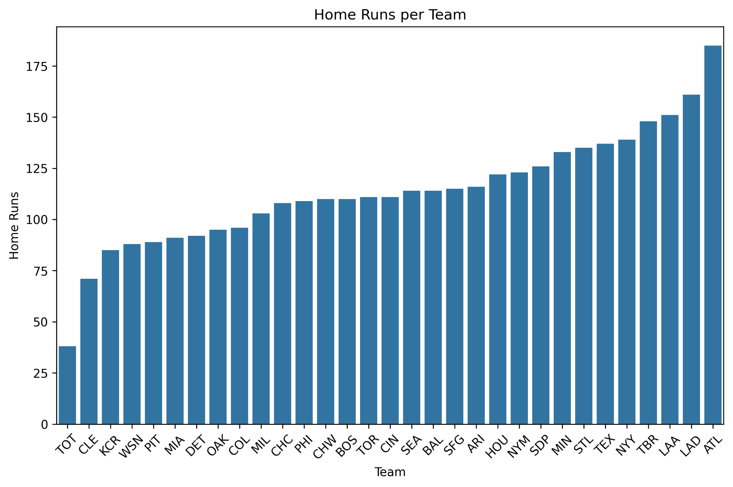
Team Home Run Count
The total number of home runs per team is a fair indication of the team's record. Top 5 records in MLB in 2023 shown below:
09.17.XX
10.13.XX
Team | Wins | Losses
Atlanta | 104 | 58
Baltimore | 101 | 61
Los Angeles | 100 | 62
Tampa Bay | 99 | 63
Milwaukee | 92 | 70

Slide 5
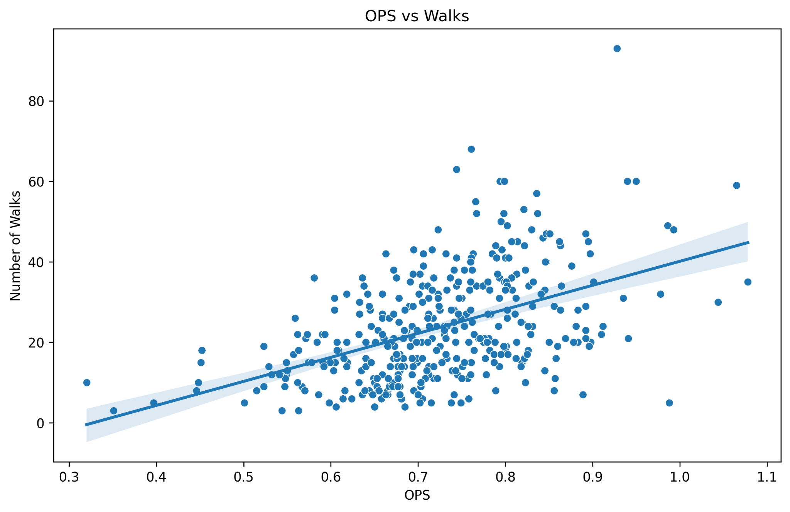
Is there a trend between OPS and Walks?
There is a general trend between OPS and number of walks, which would make sense as pitchers would be more likely to pitch around or intentionally walk the best hitters.
Correlation Coefficient = ~0.481
09.17.XX
10.13.XX

Slide 6
Age Impact

Slide 7
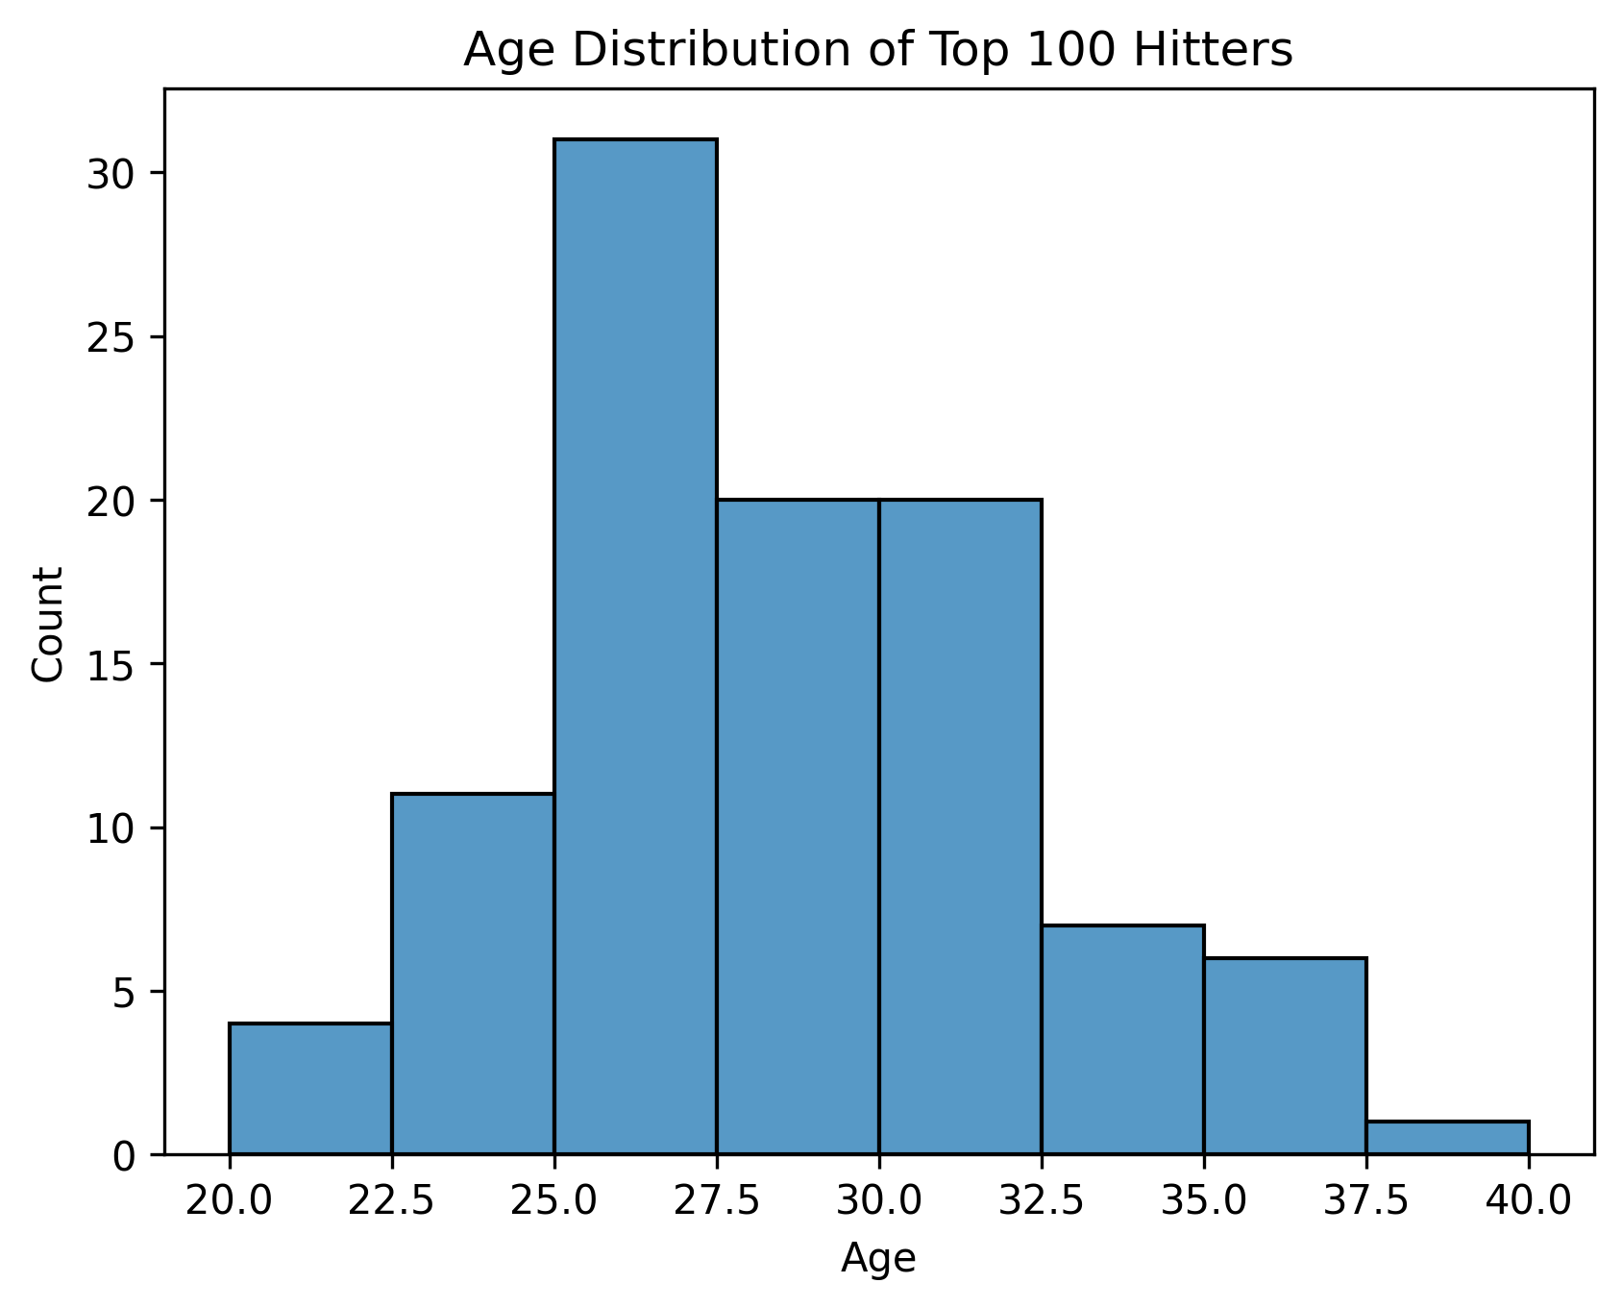
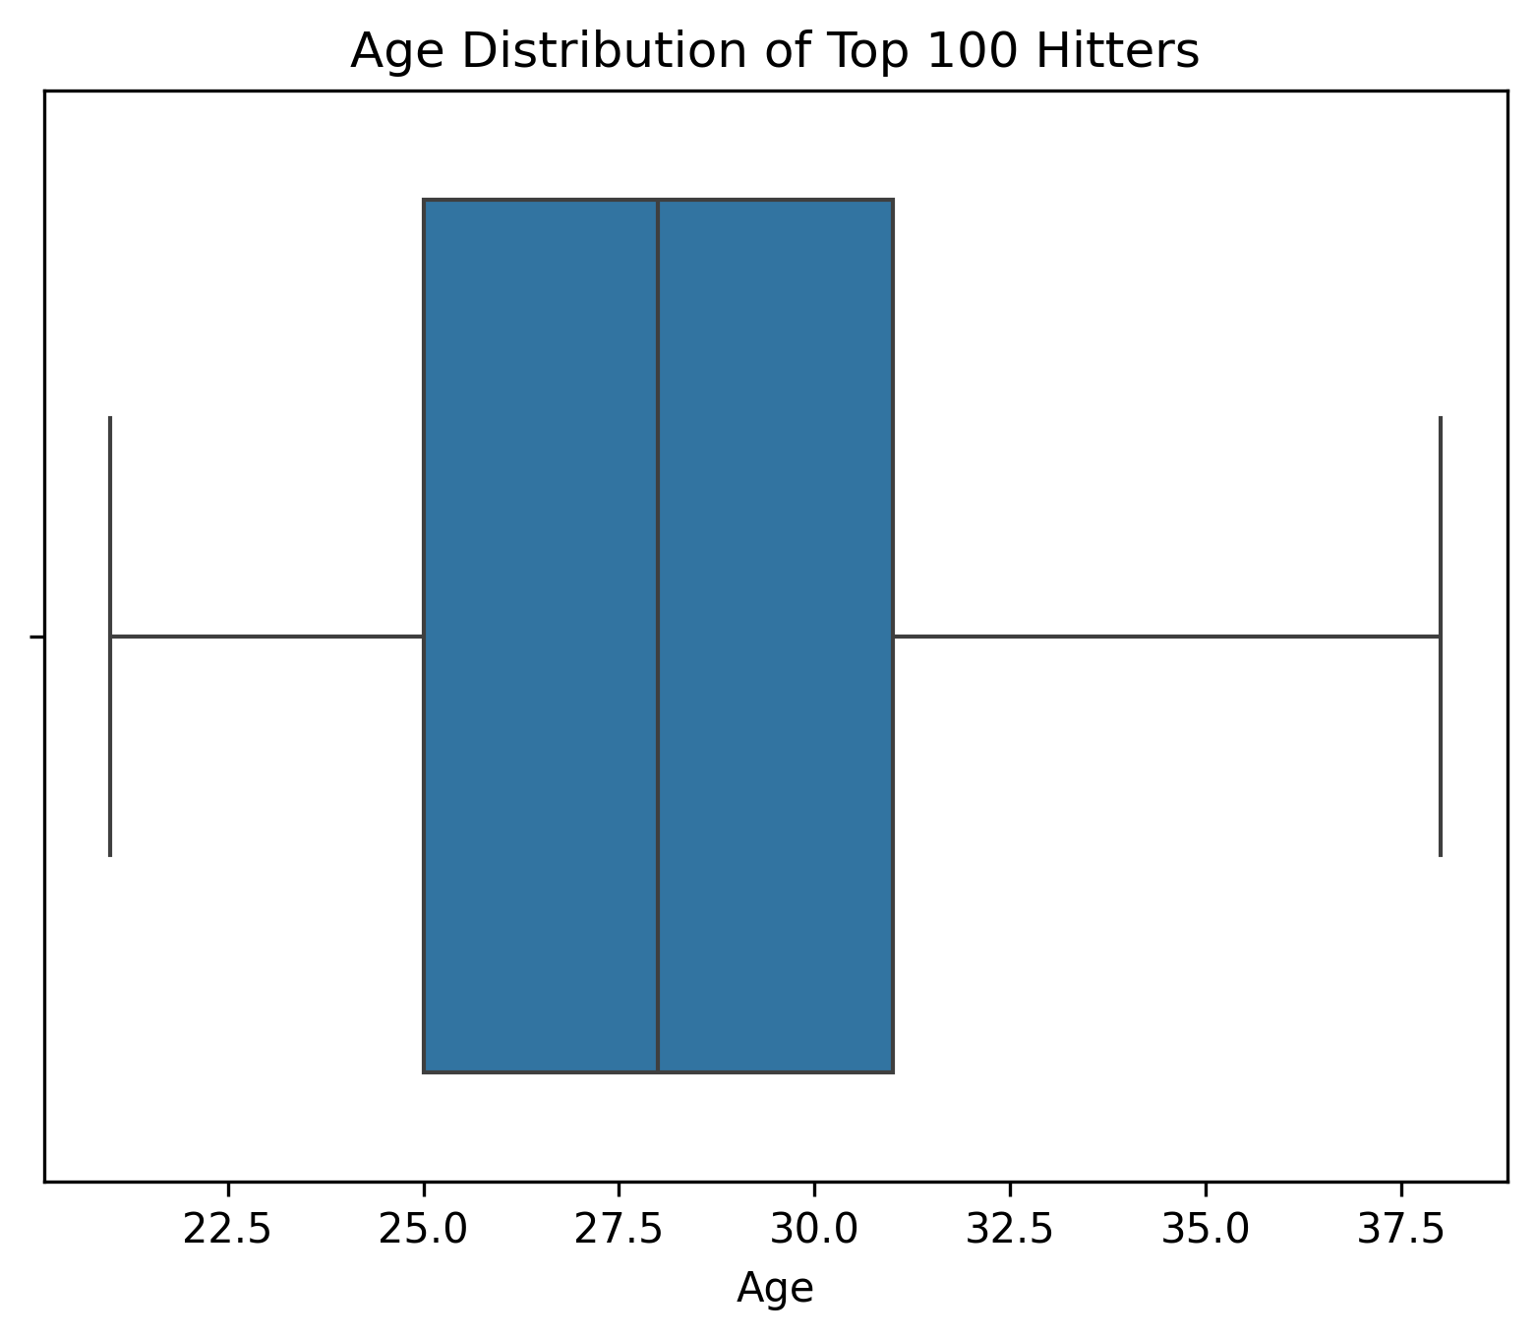
What is the age distribution of the top 100 hitters based on OPS?
10.13.XX

Slide 8
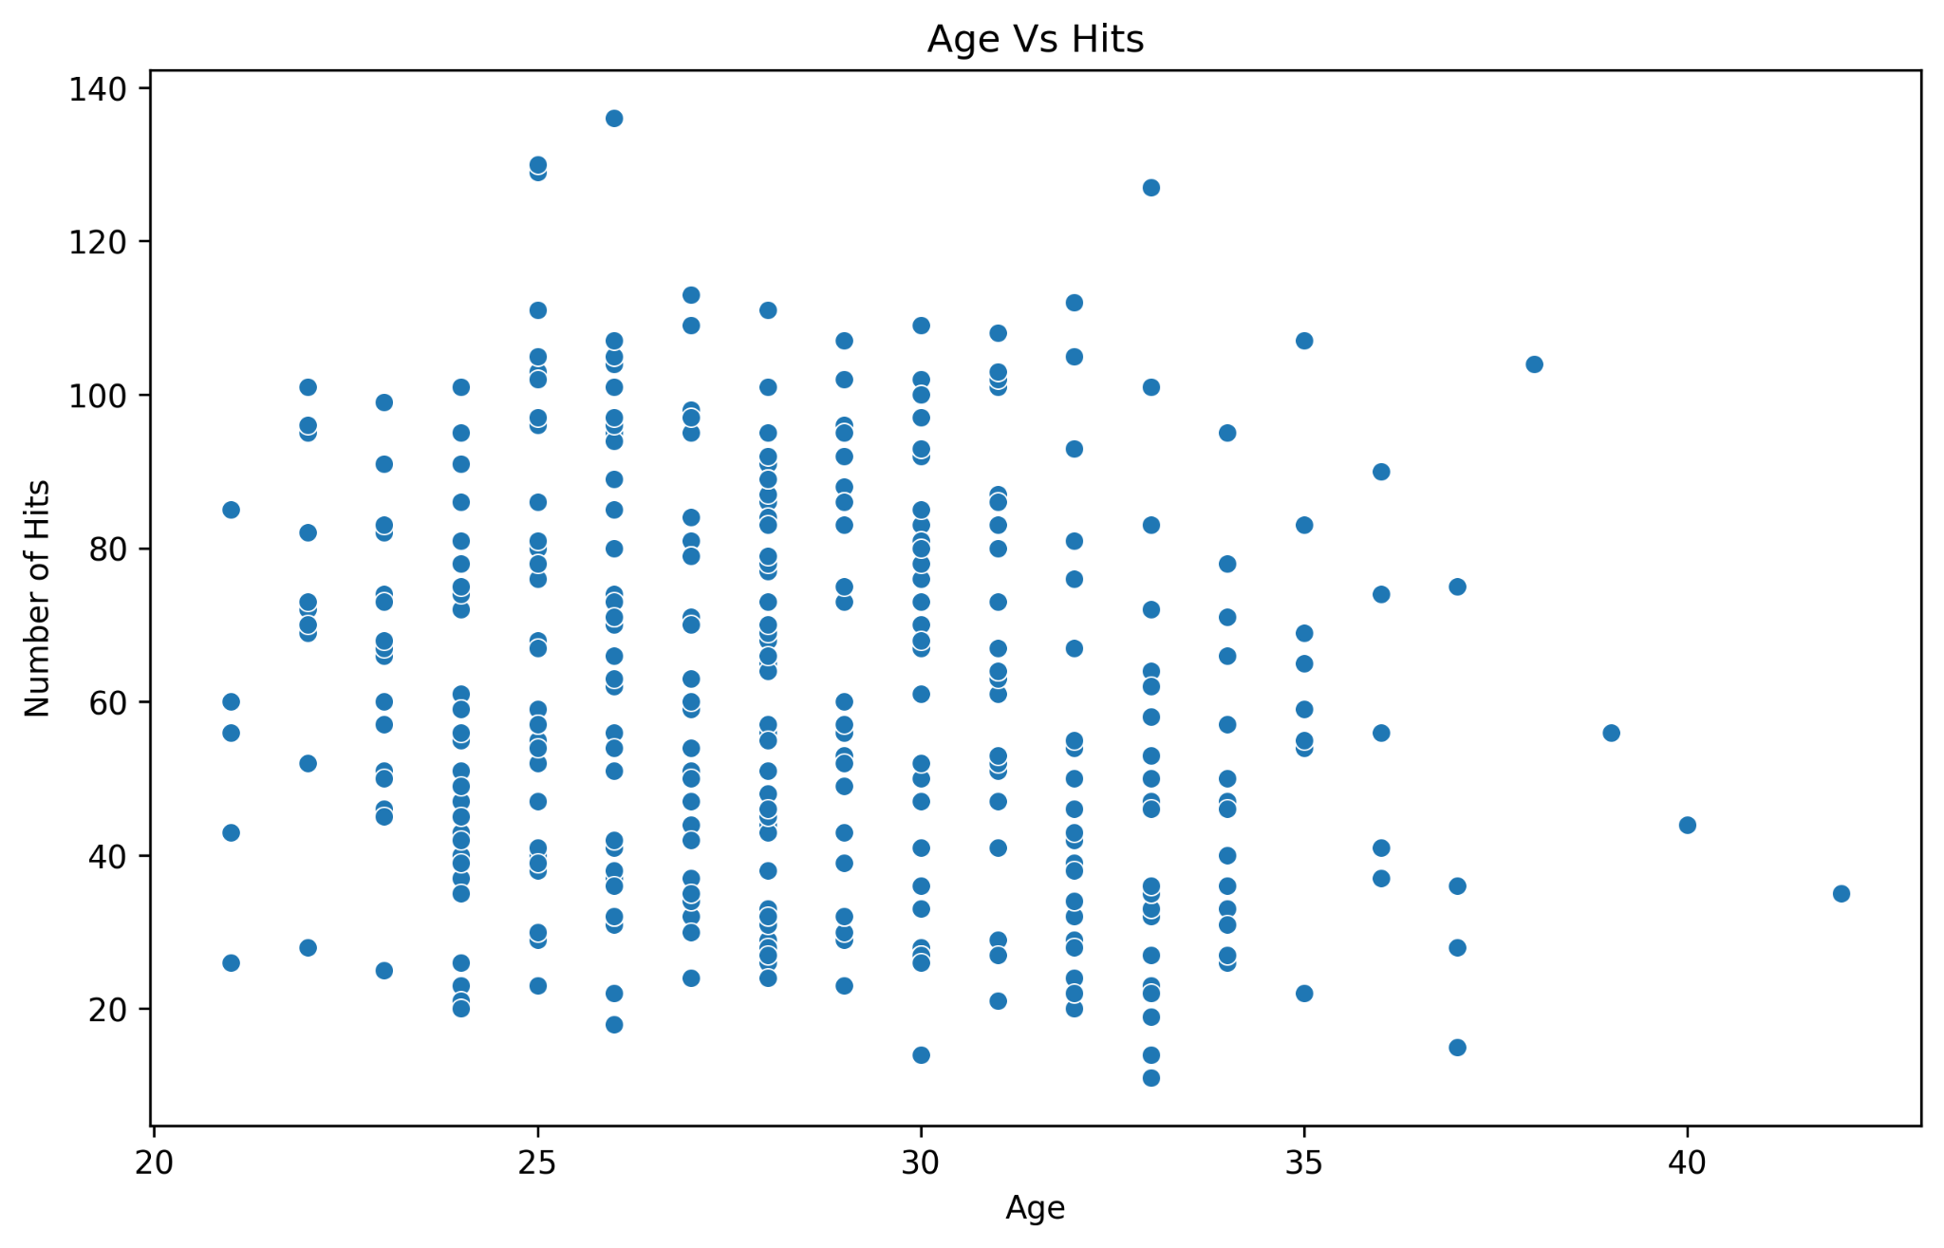
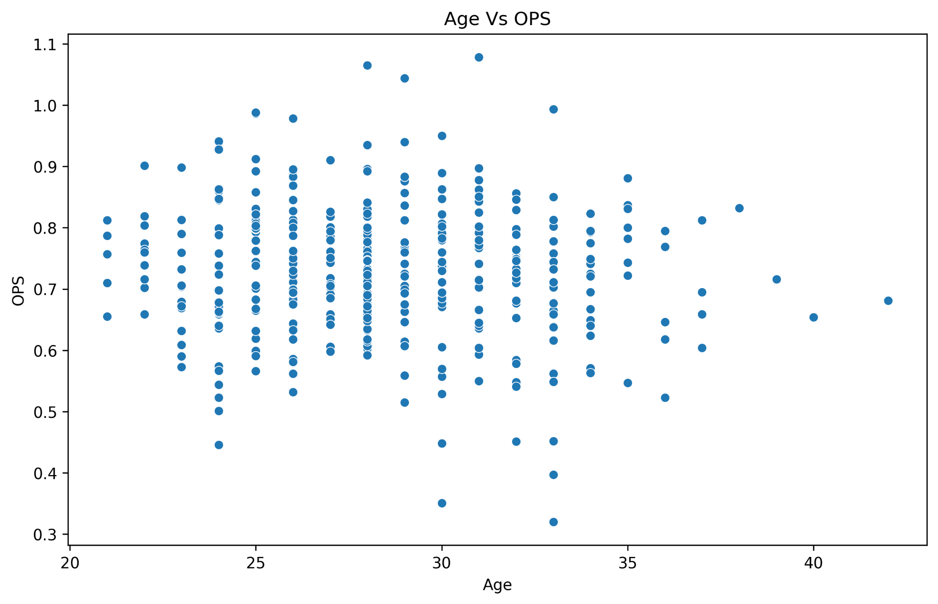
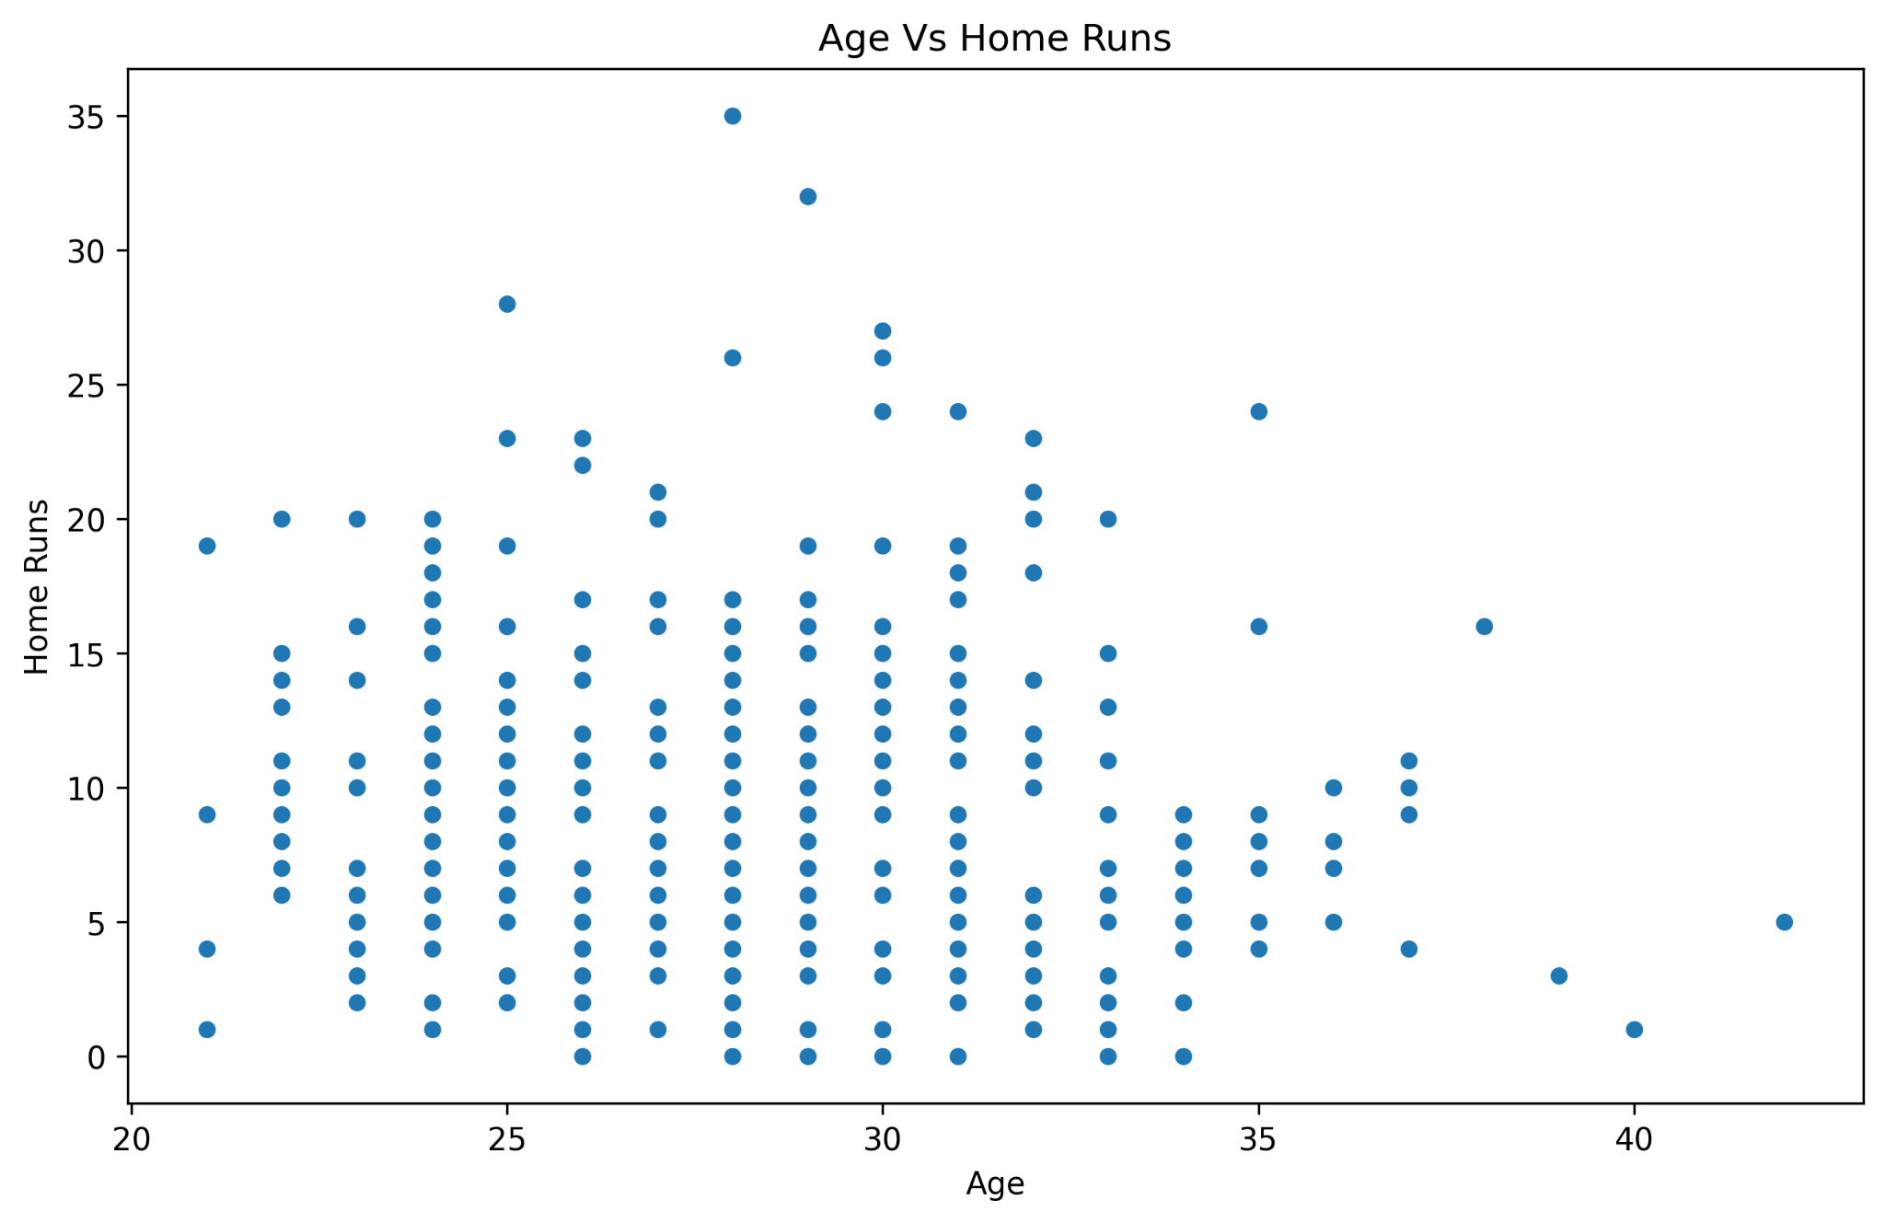
Does Age Impact Hitters Stats
As these three scatter plots show, there is very little correlation between age and a hitters stats, which I find interesting as I would expect a larger negative correlation between age and performance.
09.17.XX
10.13.XX

Slide 9
Top Ten

Slide 10
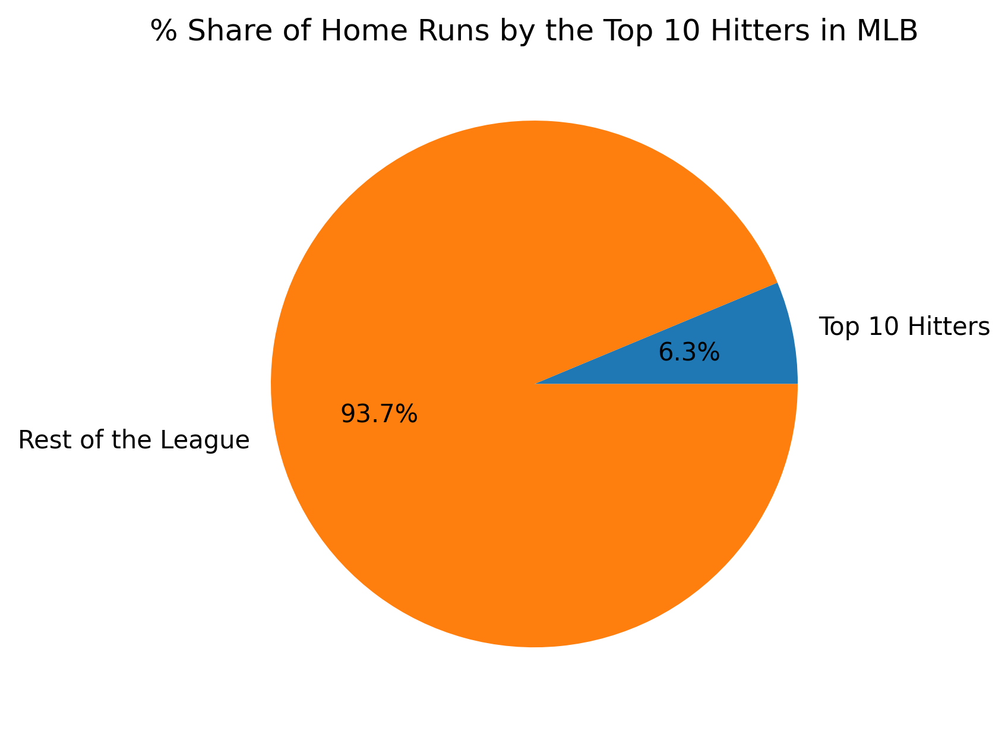
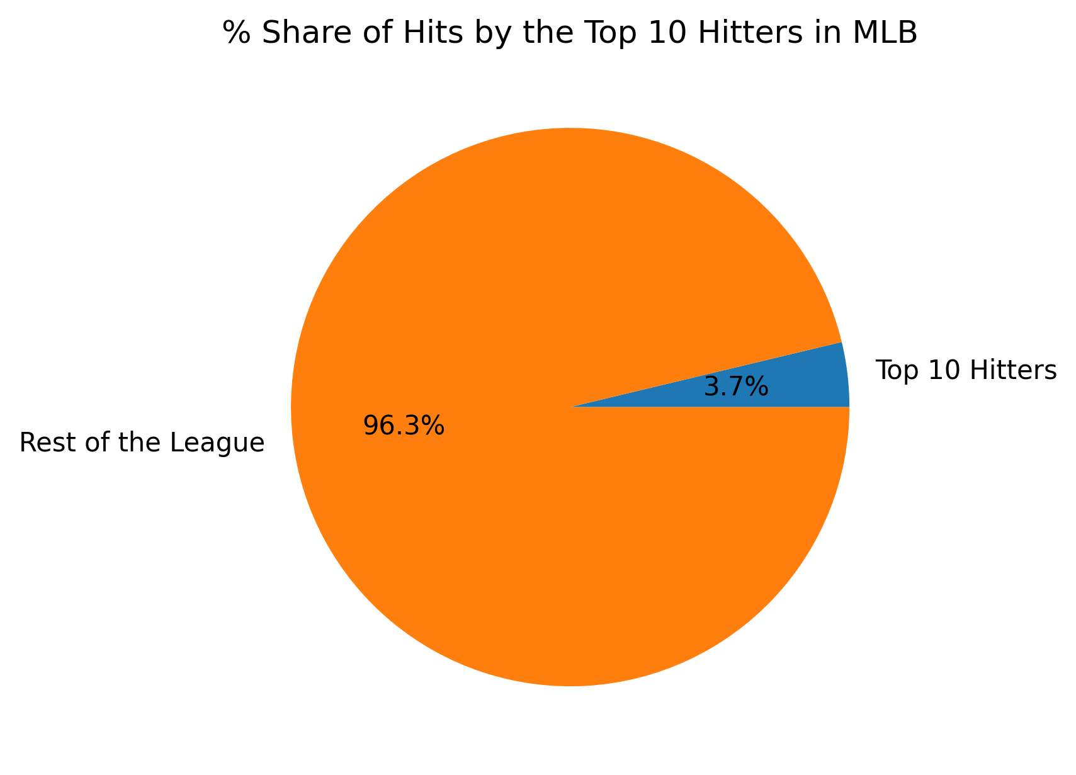
How Good are the Top 10 Hitters?
09.17.XX
10.13.XX
The top ten hitters have a surprising low percent ownership of the total number of home runs and hits in the league.

Slide 11
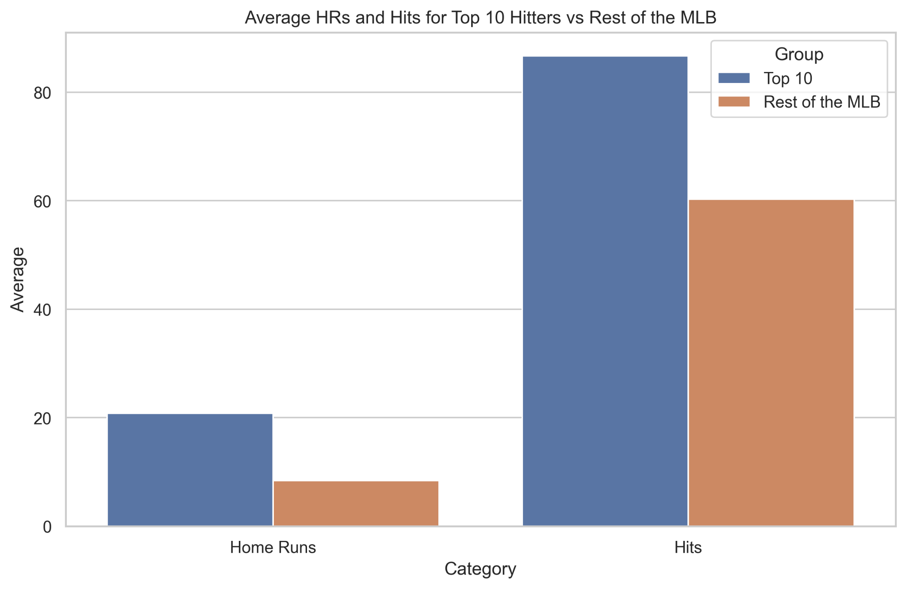
How Good are the Top 10 Hitters?
10.13.XX
This shows the real story of how much better the top ten hitters are than the average player in the rest of the league.

Slide 12
Conclusions
Trends can be found between the teams with the best records and their hitters performances
Age does not seem to have a correlation with performance
While not having a large percentage of the whole, the top 10 hitters are significantly better than the average player

